Slide 1
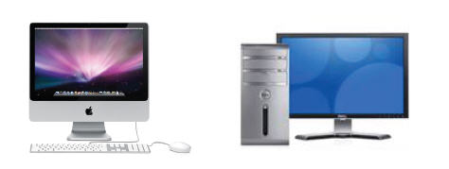
Chapter 1
Desktop Computer
Slide <number>
© 2012 EMC Publishing, LLC
Notes:
- This week I will intro the lingo so a lot of terms used in computing
- A desktop computer and its components are designed to fit on or under a desk.
Central Processing Unit is on a single computer chip.
- Mainframe=large computer system that supports multiuser applications and tasks that require the storage and processing of huge amounts of data.
Used in: large corporations, banks, airlines, government agencies, universities…
- Supercomputers= the fastest and most powerful type of computers. Used for weather forecasting and nuclear energy research.

Slide 2
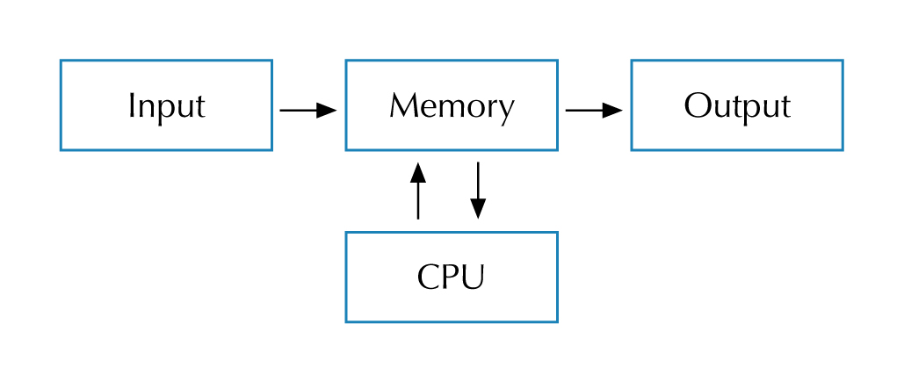
Chapter 1
Data Flow
Slide <number>
© 2012 EMC Publishing, LLC
Notes:
- The physical components are referred as hardware
All data flows through the CPU.
- Input: Examples?
keyboard, mouse, scanner, microphone, camera, DVD drive
- Output: Examples?
monitor, printer, speakers
- Motherboard contains:
expansion boards ( sound cards, video adapters, extra memory )
CPU ( contains ALU=Arithmetic Logic Unit which performs arithmetic and logic operations in nanoseconds ). The speed of the CPU is determined by the Clock Rate (MHz or GHz)
- Bus=set of circuits that connects all: Address Bus ( carries memory addresses), Control Bus ( carries Control signals )
- Memory stores data electronically: ROM ( most basic operating instructions ), RAM ( fast memory ), secondary memory ( HDD, DVD…), SRAM ( Static RAM-> high speed memory referred as cache=stores frequently used data )

Slide 3
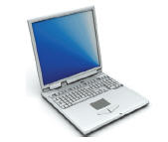
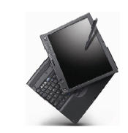
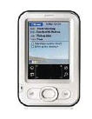

Chapter 1
Mobile Computing Devices
Slide <number>
© 2012 EMC Publishing, LLC
Notes:
Examples of mobile computing devices.

Slide 4
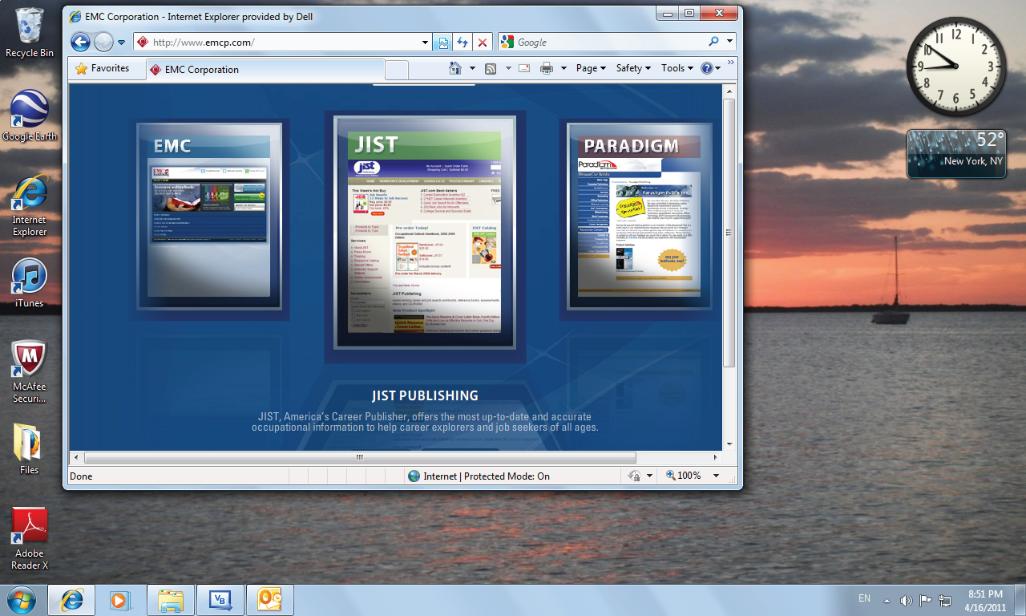
Chapter 1
Windows 7 Operating System
Slide <number>
© 2012 EMC Publishing, LLC
Notes:
- OS is run automatically when computer is turned on. Controls the computer and its peripherals, runs application software.
Examples? MAC, Windows, Unix/Linux
Application SW is written by programmers to perform a specific task in conjunction with the OS ->They are OS specific.
Environment=computer’s HW and SW configuration
OS have minimum requirements: CPU speed, RAM, HDD available
Most OSs run with GUI

Slide 5
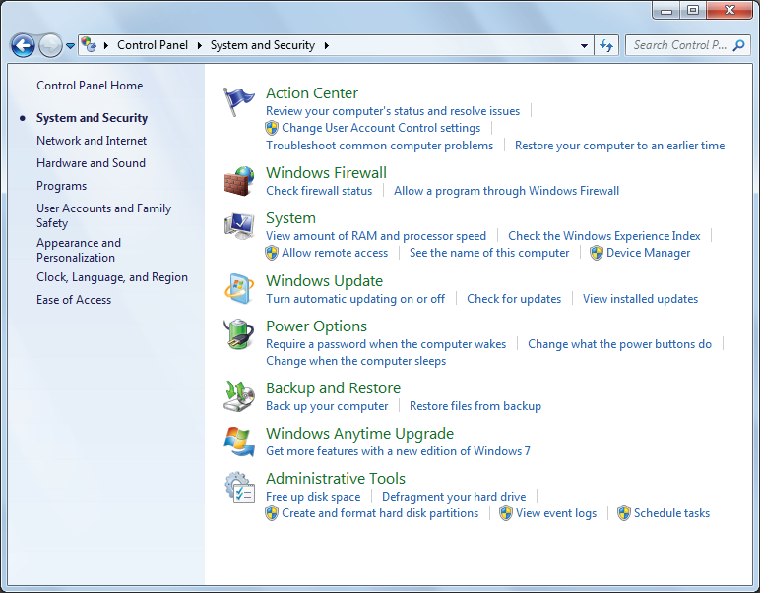
Chapter 1
Windows 7 Utilities
Slide <number>
© 2012 EMC Publishing, LLC
Notes:
Windows 7 Utilities.
-_x000f_OS functions are implemented through utility programs which have one clearly defined task. Utility programs manage input and output, read and write to memory, manage the processor, maintain system security and manage files and disks.
- Device Driver=utility specialized on some computer part/device: printing, viewing graphics, using a CD and using peripherals in general.
Some utility programs load when computer starts and are called memory-resident because they are always in the memory.
Utilities can be added to expand its functionality
- Cross-platform connectivity is the ability of one type of computer to link and share data with a different type of computer. See parallel and Microsoft Visual Basic.

Slide 6
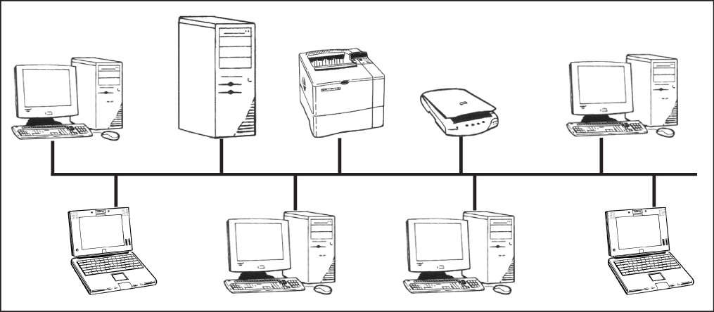
Chapter 1
LAN Using a Bus Topology
Slide <number>
© 2012 EMC Publishing, LLC
Notes:
Network= combination of HW and SW that allows computers to exchange data and share software and devices ( printers for example )
Advantages: Examples?
Users can reliably share and exchange data
Reduces costs by sharing devices
Security: login/password, rights. Can control access to certain files
Simplifies file management through centralized SW updates and file backups
Provide communication tools : email…
Networks classified by size: HAN, LAN, MAN, WAN
Computers contain NIC. Cables or wireless between nodes.
NOS=Network Operating System.
2 types of network:
peer-to-peer
Client/server
Topologies ( how computers are interconnected):
Bus
Star
ring
The bus topology is a physical LAN topology that uses a single central cable, called the bus or backbone to attach each node directly.

Slide 7
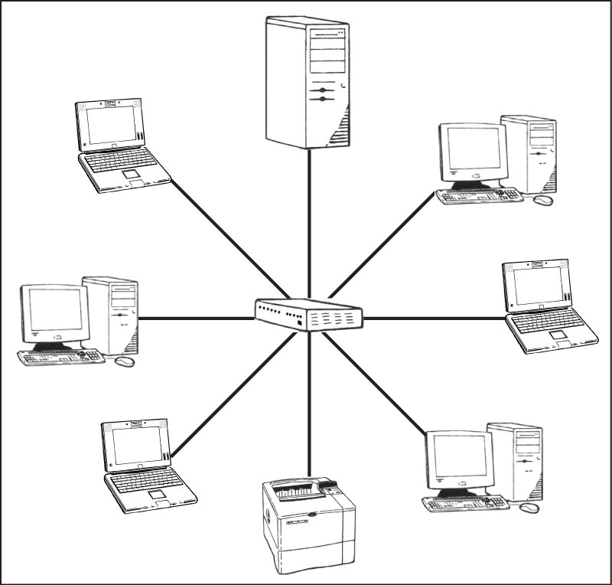
Chapter 1
LAN Using a Star Topology
Slide <number>
© 2012 EMC Publishing, LLC
Notes:
In a star topology, each node is attached to a hub, which is a device that joins communication lines at a central location on the network.

Slide 8
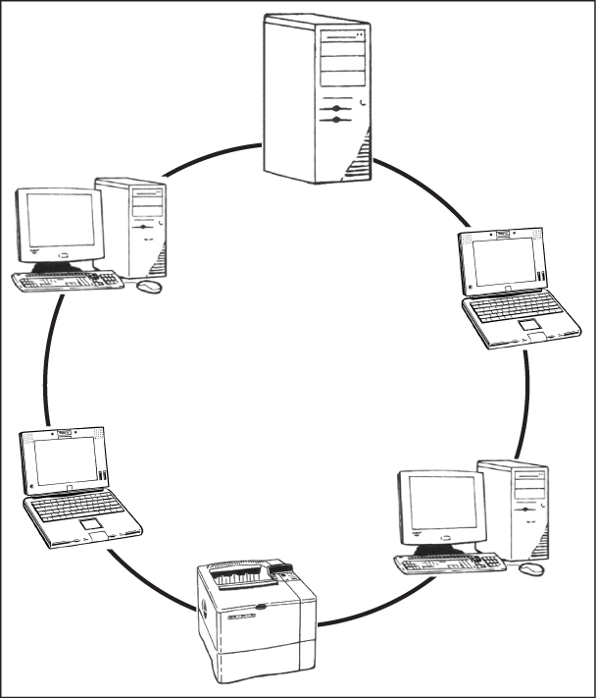
Chapter 1
LAN Using a Ring Topology
Slide <number>
© 2012 EMC Publishing, LLC
Notes:
In a ring topology, each node is connected to form a closed loop. A LAN with a ring topology can usually cover a greater distance than a bus or star topology.

Slide 9
Chapter 1
Decimal to Binary
Decimal Binary Base 2 Equivalent
0 0 =0×2¹+0×2⁰ =0×2+0×1 =0+0
1 1 =0×2¹+1×2⁰ =0×2+1×1 =0+1
2 10 =1×2¹+0×2⁰ =1×2+0×1 =2+0
3 11 =1×2¹+1×2⁰ =1×2+1×1 =2+1
4 100 =1×2²+0×2¹+0×2⁰ =1×4+0×2+0×1 =4+0+0
Slide <number>
© 2012 EMC Publishing, LLC
Notes:
In the binary, or base two, number system, each place value is represented by a power of 2.
Bits are grouped in bytes ( 8 bits ) to represent a number or a letter -> ASCII or UNICODE
Every letter of an alphabet has a representation in UNICODE ( uses a set of 16 bits )

Slide 10
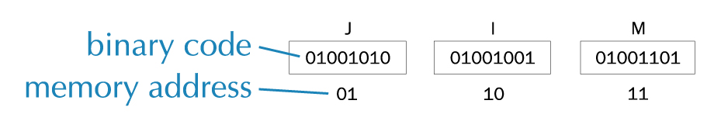
Chapter 1
Storing Data in Memory
Slide <number>
© 2012 EMC Publishing, LLC
Notes:
Computer memory is measured in bytes. 1 MB-> 2²⁰=1,048,576 bytes. 1 GB->2³⁰=1,073,741,820 bytes.
Data stored in the memory is referred by its address. Address is a unique binary representation of a location in memory.
The binary representation of an integer is usually stored in 4 bytes of memory ( 32 bits ). Range is given by 2³²= -2,147,483,648 to 2,147,483,647. An overflow error occurs when the number of bits that are needed to represent the integer is greater than the size of 4 bytes.
Real numbers called also floating point numbers contain decimal points. Representation is 4 to 8 bytes

Slide 11

Chapter 1
E-mail Address
Slide <number>
© 2012 EMC Publishing, LLC
Notes:
An e-mail address is required in order to send and receive e-mail messages. E-mail addresses are provided when you sign up with an ISP or an online service.

Slide 12
Chapter 1
MLA Citations
General citation for material located at a website:
  Author’s Last Name, First Name MI. “Article Title.” Site Title. Publisher Name. Last-updated date. Web. Access date. <URL>.
Slide <number>
© 2012 EMC Publishing, LLC
Notes:
A widely accepted form for citation is published by the Modern Language Association (MLA) in its publication MLA Handbook for Writers of Research Papers, Seventh Edition.

Slide 13
History of Programming Languages
Machine languages (machine code)—0s and 1s
CPU’s understand 0 (off) and 1’s (0n) , Binary.
Such instructions are called machine instructions.
2. Assembly languages
A more advanced language that uses words called Mnemonics to represent memory locations.
Ex/ mov for move and add for add.
Assembler—a program that converts assembly language instructions into machine code
Slide <number>
© 2012 EMC Publishing, LLC

Slide 14
History of Programming Languages
3. High-level languages
Allow the programmer to use English like instructions instead of pure machine or mnemonic codes.
Requires a compiler to convert the statements into machine code (OBJECT code) and link the different modules/ files into an EXECUTABLE.
Slide <number>
© 2012 EMC Publishing, LLC

Slide 15
History of Programming Languages
Procedure-oriented Languages:
- Focus is on how to accomplish a task. Program is written top down and instructs the computer from start to completion. The programmer determines program flow: COBOL, C, Pascal.
Order of the code, instructions, is critical. Programmer decides the instructions and their sequence of execution.
“BATCH” programming.
Slide <number>
© 2012 EMC Publishing, LLC

Slide 16
History of Programming Languages
Object-oriented/event-driven Languages:
Windows introduced the graphical user interface, or GUI, to provide a common look and feel to all windows programs.
- Before VB and PowerBuilder, developers spent a great deal of time writing instructions, using the windows API, to create buttons, forms…
This task was simplified with the advant of object oriented/ event driven programming.
Objects are command buttons, scroll bars, grid controls, forms, labels, text boxes, etc…
Slide <number>
© 2012 EMC Publishing, LLC

Slide 17
History of Programming Languages
Events are the things that can occur for any given object. For example, the command button has a onclick & doubleclick events, among others.
VB is considered an object oriented, event driven programming language, but it does not enforce object oriented concepts like encapsulation, polymorphism and inheritance.
Demonstration:
Run Tuition Calculator
Point out the different controls included in the interface
Menu, text box, list box, option buttons, label controls, command button
Slide <number>
© 2012 EMC Publishing, LLC

